Slide 1
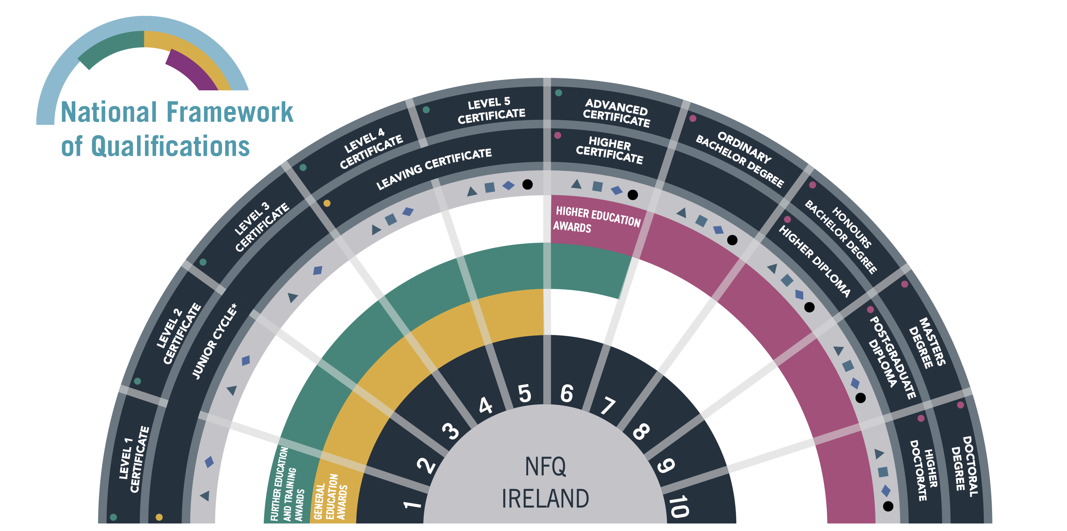
Majority of
Junior Cycle Subjects
Level 2
Learning Programmes
Level 1
Learning Programmes

